Slide 1
Dr. Mannie Ramirez
Forsyth Technical Community College
April 13th - BLC 2025
Notes:
Good morning everyone! As many of you know, I’m Mannie Ramirez. Can you believe they gave me the microphone again? Anyway, I’m from Forsyth Tech community college. We’re a two year college in north western north Carolina. I do deserve Dr, I got my PhD in cancer biology. My area was this weird intersection of molecular biology, metabolism, gtpase activation, bioactive lipids, and cancer cell stress. Back to Forsyth Tech, we’re among the five largest community colleges of the great 58 in NC. And I have to say, all you four year colleges- step it up. Especially you research universities. We’re doing so much better than you. Our students are better after two years than yours. And we actually support our students. There's a poster next door that shows it.
Anyway, you can see that my title isn’t on this slide. And that’s because I really don’t want my college’s branding materials associated with the title, so…

Slide 2
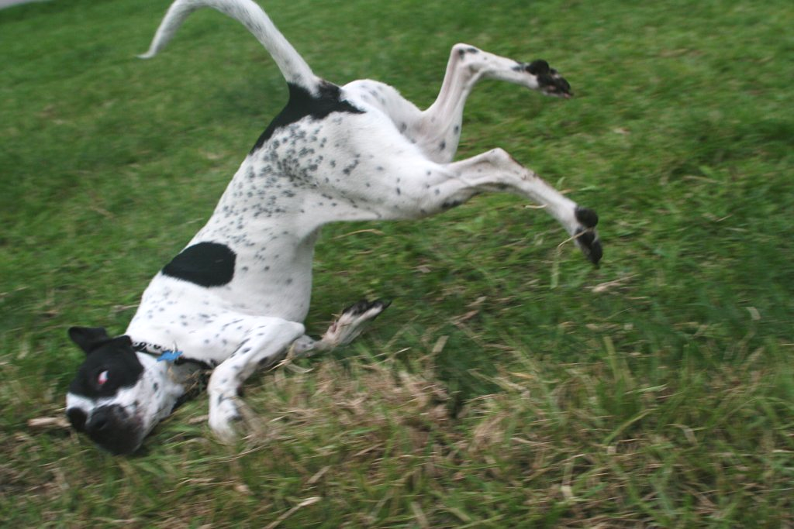
Fail in front of your students
Smith, 2006
Dr. Mannie Ramirez
Forsyth Technical Community College
April 13th - BLC 2025
Notes:
My talk is Fail in front of your students. That thing that Forsyth Tech students do NOT do.

Slide 3
How many of you have…
Had a ‘C’ final grade college?
Had an ‘F’ final grade?
Missed a deadline?
Had a grant application rejected?
10% rejected?
50%?
90%?
Hi! I’m Mannie Ramirez (no, not Manny Ramirez). I’m a professional failure.
… and you are too.
Notes:
Alright. If you all wouldn’t mind answering- how many of you got a C in any class in college?
Continue with 'f', 'deadline', grants.
…
Yeah, I feel that. Actually, let me introduce myself again. I’m Mannie Ramirez. The IE is important, not Y. Because the red sox suck. Apparently he actually retired back in 2011, I didn’t know because baseball is super boring, I don’t know why anyone would watch it when there’s soccer. Oh, another important part- I’m a professional failure. I’m a teacher, not a research scientist, so I’m a failure. I didn’t have grandkids for mom, so I’m a failure. Oh, by the way, all of you are failures too.
So I’m going to call on some of you to tell me how you’re a failure. … At least, I would if I had time for active learning.
At this point I’m guessing you’re feeling some emotions. Probably confusion. Anger, flustered, sad, hurt. And indulge me. Take a second to savor that feeling.
Because that is what your students are feeling. When they’re in class and can’t understand something no matter how many times they try. When they’re in group work and everyone but them has figured it out. When you call on them in class and they don't know the answer.
So, I’ve been doing this the upcoming activity for years with my students, but I’ve never shared it before, and that means I just made this talk.
Usually I don’t write my talks down, and I never really practice them. I perform best off-the-cuff.
But I did for this one, because I know this part would be hard and might make me choke up on stage. Because what started this activity, what eventually led me to giving this talk, is a memory. I remember a little over two decades ago, and I was sitting in algebra, and my teacher asked me a super basic math question. I can't remember if it was division or multiplication. I gave the wrong answer. And then my mind blanked. And she came back to me 3 minutes later to ask if I had figured it out, and I hadn’t. And again, three minutes later, I was terrified. My chest got tight, my throat hurt, and I was dying in front of the rest of my class.
I wrote the talk down because at this point I might need to read it to you all, because I've never shared this memory, and I didn’t know how I'd react.
Over two decades later I still physically cringe when this memory jumpscares me. It makes me want to cry.
And now, two decades later, as an educator, I can’t help but think- how the hell did they expect me to learn when I was experiencing all that?
This part is also tough because probably hurt a lot of you, and I’m so sorry I did. The BLC is the highlight of my year and I adore you all. But I need those feelings fresh, I need you to remember what it was like, because it’s why my talk is important. Because your students are having these feelings, and they learn so much better without them.
But failure is important. Failure is how we learn. Failure, or the wrong answer, makes our brain cling to the correct answer. We're a societal species. If we have the wrong answer again, we might be kicked out and on our own. We cling to what we didn't know, even more than what we got correct.
Second- science is failure. Something doesn't work and we ask why. We try something, and it doesn't work, and we try something new.
It's called research. If it worked the first time, we'd call it search. And we'd all be out of jobs. And it would be so boring knowing everything.

Slide 4
Fail in front of your students Humanizing the Biology Classroom Through Vulnerability
Fail in front of your students Humanizing the Biology Classroom Through Vulnerability
Smith, 2006
Dr. Mannie Ramirez
Forsyth Technical Community College
April 13th - BLC 2025
Notes:
Here’s the full title of my talk. Fail in front of your students. Humanizing the biology classroom through vulnerability. Why are those two terms important? We’re scientists. We deal with facts. Not squishy fluffy liberal arts ideas like ‘humanizing’ or ‘vulnerability’. So why do I even have them here? Because, if you’re not, your students aren’t learning as much as they could.

Slide 5
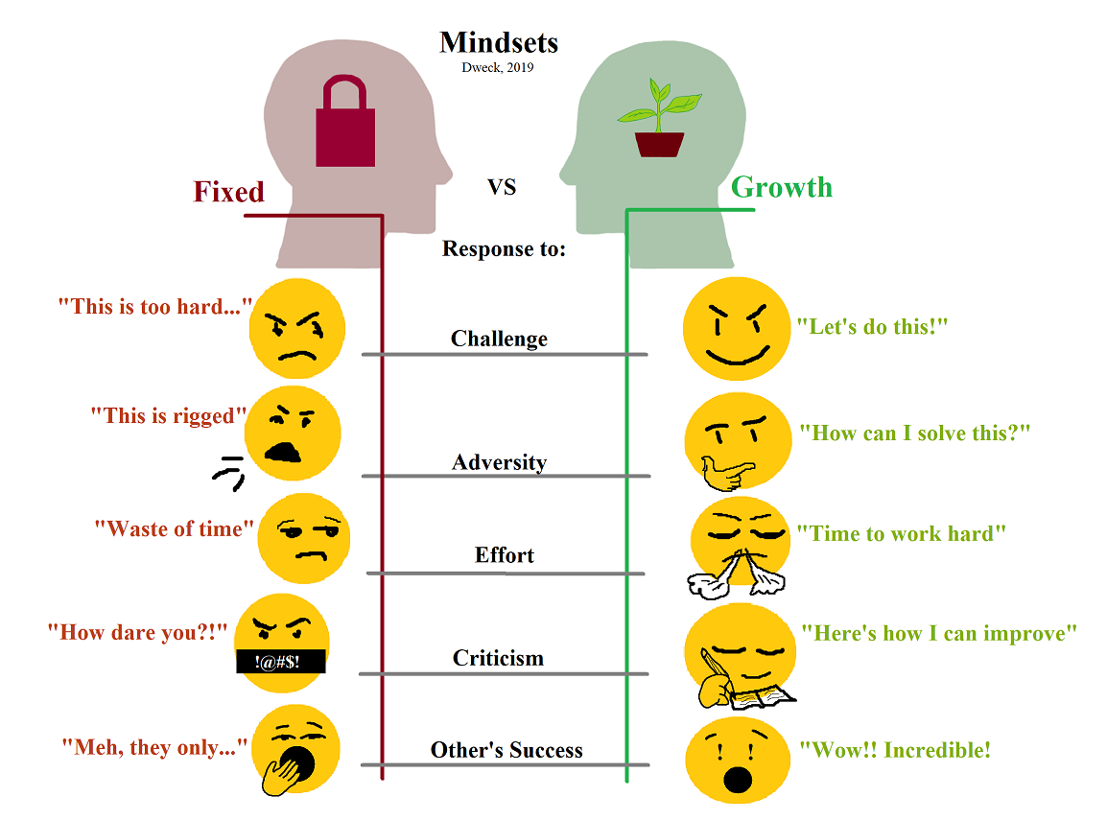
Humans, Not Robots (yet)
The ‘Perfect Professor’ myth creates unrealistic expectations
Discourages questions and risk-taking
Encourages ‘fixed mindset’ thinking
Dweck, 2019
Notes:
We're all humans. If you're secretly a lizard person like the conspiracy theory, please keep that to yourself. But we're certainly not robots. And I assure you, AI will not take over teaching- but that's the talk I gave last week.
Since we’re human, we have to get rid of a very persistent myth- the perfect professor myth.
Go over points, figure.

Slide 6
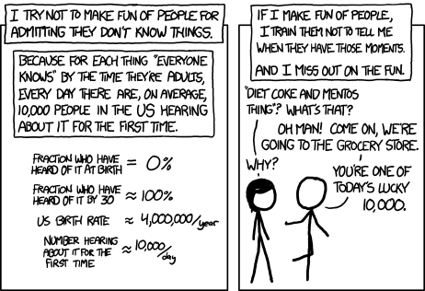
We all have knowledge gaps (educators are just masters at hiding it)
Advantage in breadth of knowledge
Trained to answer questions ‘intelligently’
Thank you graduate school!
XKCD
Notes:
One of the tough parts about humanizing us- we have knowledge gaps. But we're masters at hiding it.
Go over points
Figure- Don't have time to read it, brief explanation. In PPT for them to reference.

Slide 7
Humanization and a Healthy Learning Environment
Stronger Sense of Belonging
Increased Student Engagement
Willingness to Take Intellectual Risks
Decreased Fear Response
Notes:
Get rid of the ‘perfect professor’ myth. Show our knowledge gaps.
Humanizing means our students see we aren't some unachievable god of knowledge. They realize that we're like them. We're addressing imposter syndrome- we, like them, struggle. We make mistakes. Sometimes, we fail. BUT WE STILL BELONG HERE.
This leads to students being more wiling to talk with us, to engage with the material, to be wrong. They become risk takers. That growth mindset.
And most important- the fear response is gone. They're not in algebra, frozen, terrified because they're going to be called on again in another three minutes.

Slide 8
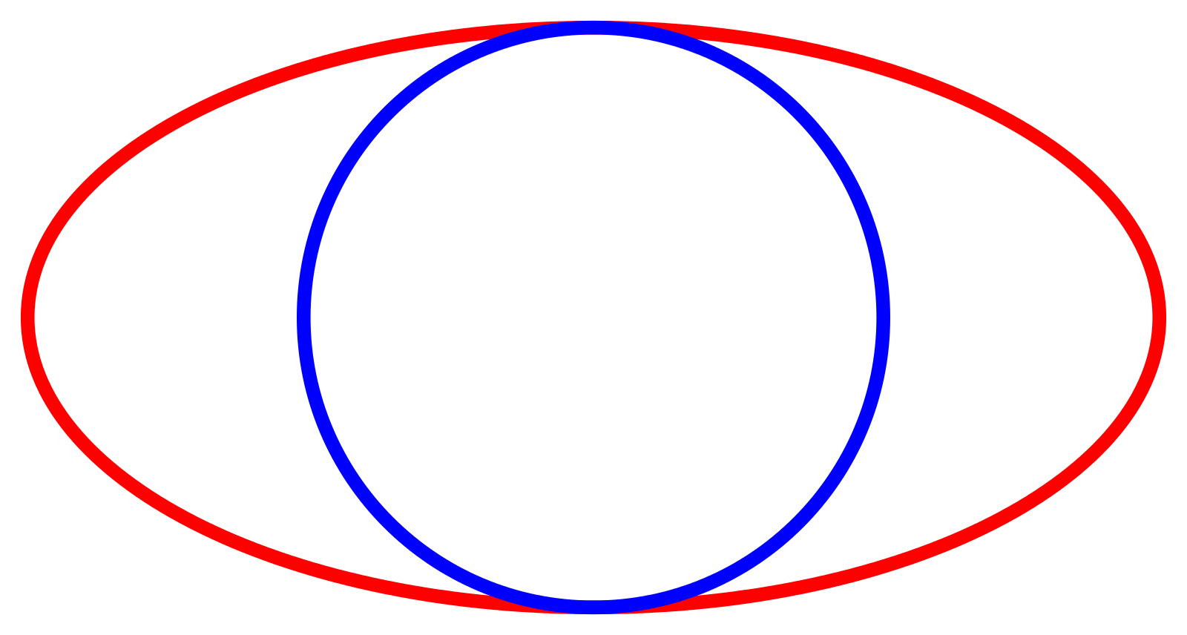
A quick aside...
How does the earth orbit the sun?
In an ellipse (red)?
In a circle (blue)?
Earth
Sun
Notes:
Actual in-class technique:
Great non-cliker/tech poll technique:
Hand open- Ellipse
Hand closed- circle
(audience dependent).
100% of my students get this wrong. They think we go around in an oval. Isn't that silly? Our orbit isn't a perfect circle, but it's closer than an oval.
And then they think we orbit the sun. Isn't that absurd? We orbit the Barycenter
Oh, that's wrong too. We don't orbit- we don't make circles. We're more like corkscrewing through space, because the sun is moving too.
If time- 'volume' of box example. Car gas vs gas.

Slide 9
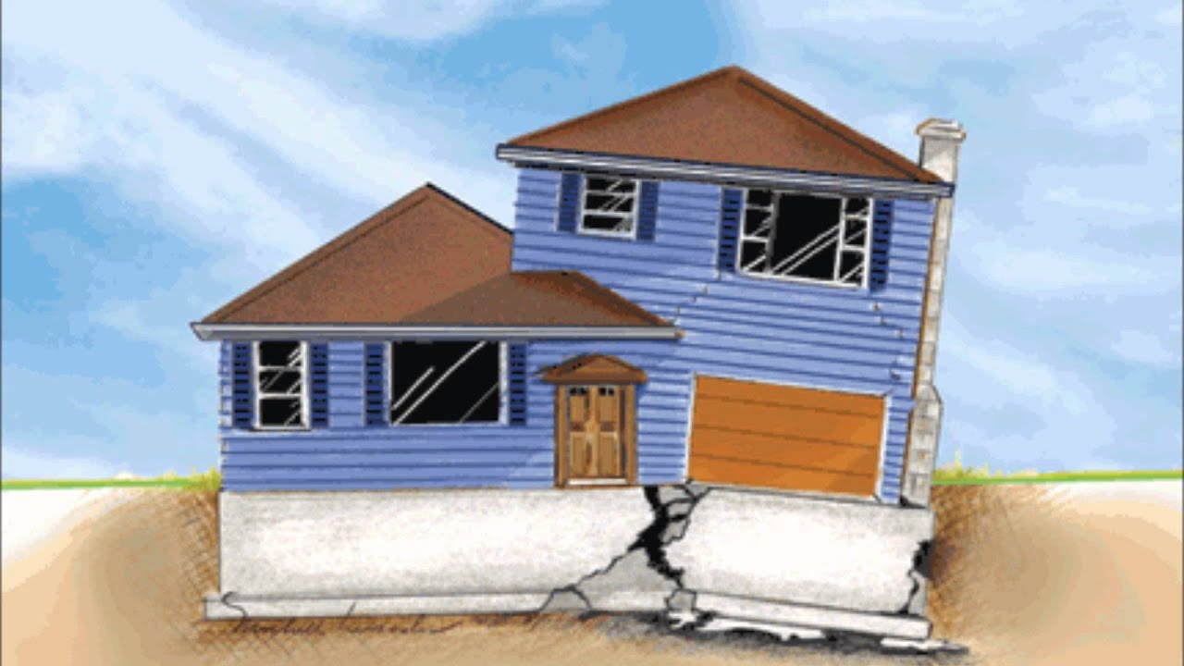
Misconceptions: Faulty Foundations
Misconceptions are reality
Adding new information atop a misconceptions leads to confusion
Finding the source of a misconception reduces negative responses
Notes:
We all have misconceptions – even us, expert learners.
Danger of misconceptions.
How to assuage misconceptions.
Mine- taut vs taunt; how to say 'matinee'; thought beaver wasn't a fish. (that's another lecture).

Slide 10
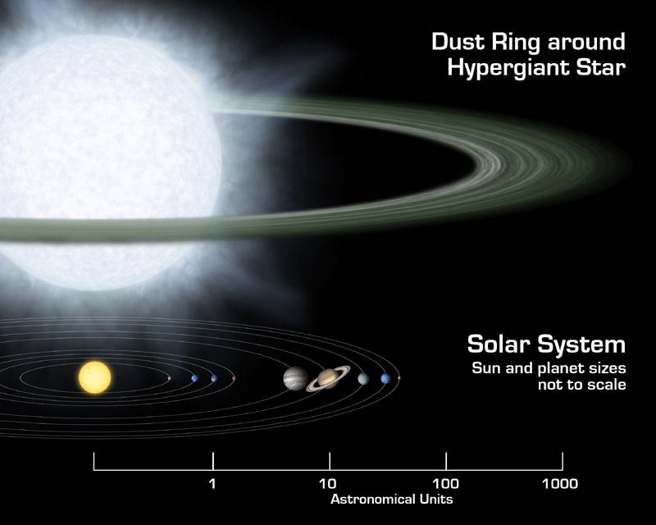
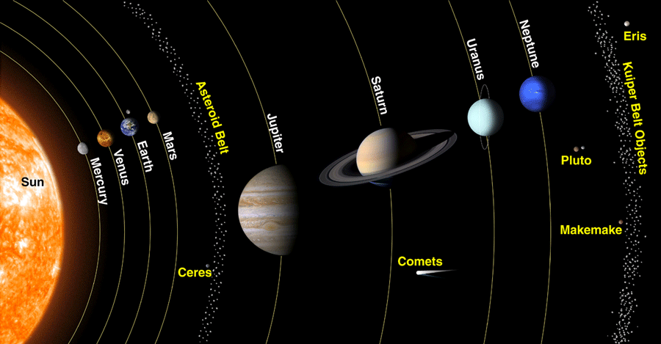
Our solar system isn’t like that (but often looks like that)
Nasa, 2019 & 2022
Notes:
Misconceptions come from a place-
Ref others:
Eyes project light
Plants photosynthesize with green
Dark side of the moon'
Blood is blue
What a 'theory' is

Slide 11
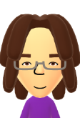
I’m Dr. Mannie Ramirez, and sometimes I fail
I have a really bad attention span, so I might miss your raised hand
I may make grading mistakes. Please call me out on them!
Sometimes I miss an email. After 48 hours, please send one again.
I say the wrong thing sometimes- call me out on it!
And it’s okay if, sometimes, you fail too.
Just keep getting back up and trying again.
Notes:
In class demo:
Mention lecturer 1 wrong/hour

Slide 12
Pop Quiz Time!
For me. Ask me anything, on any (appropriate) topic.
Notes:
Take questions if time (5 min left)
Example of questions:
Year of slavey
Gender/sex
Provide 'fluff' answer- and teach students not to

Slide 13
Why I like the teacher quiz:
Reduced anxiety about asking questions
More willingness to attempt difficult concepts
Increased class participation
Development of growth mindset
Better answers from students
Notes:
Seeing teacher 'fail' = less fear of 'fail'

Slide 14
Or maybe I just failed you?
The importance of striking a balance
Being overly-transparent can pressure students
Instructor identity can impact this tactic
Some publications find this tactic hinders education
Notes:
Mention disgust: instructor identity; repulsion

Slide 15
The person who never made a mistake never tried anything new. - Albert Einstein

Slide 16
Thank you.
Notes:
Thank you all for your time, for letting me talk, and letting me be vulnerable in front of you. I hope it helped you learn.

Slide 17
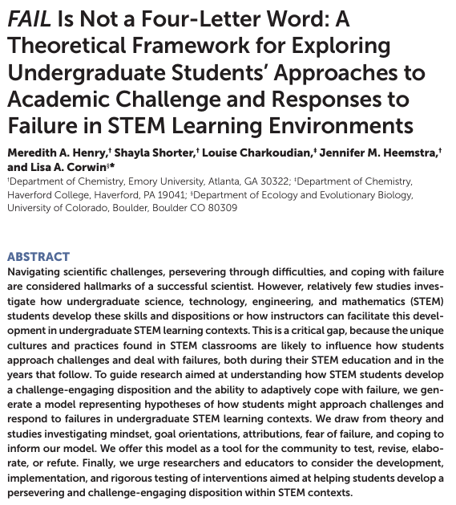
Questions?
Henry, 2019
XKCD
Notes:
I started this activity all on my own. Amusingly- us professors can always prove wer're correct, right? Here's the perfect paper to support my tactic. And the rest of my references are on the next slide.
One last thing- Your students always know less than you think they do.
Questions?

Slide 18
References
Slide 2 & 4:
Smith, B. (2006). Dog tumbling into faceplant. Sirenbrian @ Flickr. https://www.flickr.com/photos/sirenbrian/155160053
Slide 5:
Cox, R. D. (2009). The college fear factor: How students and professors misunderstand one another. Harvard University Press.
Bjork, E. L., & Bjork, R. A. (2011). Making things hard on yourself, but in a good way: Creating desirable difficulties to enhance learning. In Psychology and the Real World: Essays Illustrating Fundamental Contributions to Society (pp. 59-68).
Dweck, C. S., & Yeager, D. S. (2019). Mindsets: A view from two eras. Perspectives on Psychological Science, 14(3), 481-496. https://doi.org/10.1177/1745691618804166
Slide 6:
XKCD. (n.d.). Ten thousand. https://xkcd.com/1053/
Slide 7:
Cooper, K. M., Haney, B., Krieg, A., & Brownell, S. E. (2017). What's in a name? The importance of students perceiving that an instructor knows their names in a high-enrollment biology classroom. CBE—Life Sciences Education, 16(1), ar8. https://doi.org/10.1187/cbe.16-08-0265
Verbree, A.-R., van der Schaaf, M., Wijngaards-de Meij, L., & Dilaver, G. (2025). Students' sense of belonging and authenticity in higher education. British Educational Research Journal. https://doi.org/10.1002/berj.4114
Mazer, J. P. (2013). Associations among teacher communication behaviors, student interest, and engagement: A validity test. Communication Education, 62(1), 86-96. https://doi.org/10.1080/03634523.2012.731513
Cavanagh, A. J., Chen, X., Bathgate, M., Frederick, J., Hanauer, D. I., & Graham, M. J. (2018). Trust, growth mindset, and student commitment to active learning in a college science course. CBE—Life Sciences Education, 17(1), ar10. https://doi.org/10.1187/cbe.17-06-0107

Slide 19
References
Slide 7 (cont):
Henry, M. A., Shorter, S., Charkoudian, L., Heemstra, J. M., & Corwin, L. A. (2019). FAIL is not a four-letter word: A theoretical framework for exploring undergraduate students' approaches to academic challenge and responses to failure in STEM learning environments. CBE—Life Sciences Education, 18(1), ar11. https://doi.org/10.1187/cbe.18-06-0108
Slide 10:
NASA. (2019). Supersized disk. Spitzer Space Telescope. https://www.spitzer.caltech.edu/image/ssc2006-05b-supersized-disk
NASA. (2022). James Webb Space Telescope Senior Science Series. Goddard Space Flight Center. https://science.gsfc.nasa.gov/691/JWSTSSS/index.html
Slide 14:
Jayakumar, U. M., Howard, T. C., Allen, W. R., & Han, J. C. (2009). Racial privilege in the professoriate: An exploration of campus climate, retention, and satisfaction. The Journal of Higher Education, 80(5), 538-563. https://doi.org/10.1080/00221546.2009.11779031
Chory, R. M., & Offstein, E. H. (2017). Your professor will know you as a person: Evaluating and rethinking the relational boundaries between faculty and students. Journal of Management Education, 41(1), 9-38. https://doi.org/10.1177/1052562916647986
Slide 17:
Henry, M. A., Shorter, S., Charkoudian, L., Heemstra, J. M., & Corwin, L. A. (2019). FAIL is not a four-letter word: A theoretical framework for exploring undergraduate students' approaches to academic challenge and responses to failure in STEM learning environments. CBE—Life Sciences Education, 18(1), ar11. https://doi.org/10.1187/cbe.18-06-0108
XKCD. (n.d.). Average Familiarity. https://xkcd.com/2501/

